Slide 1
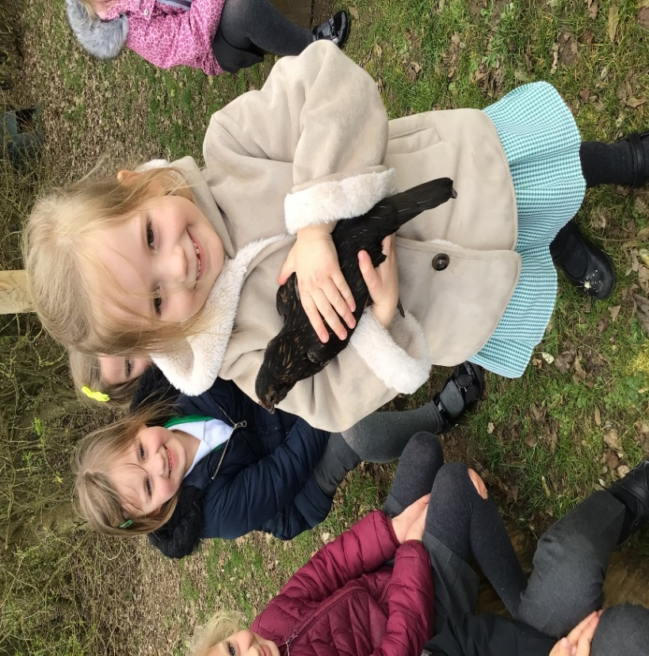
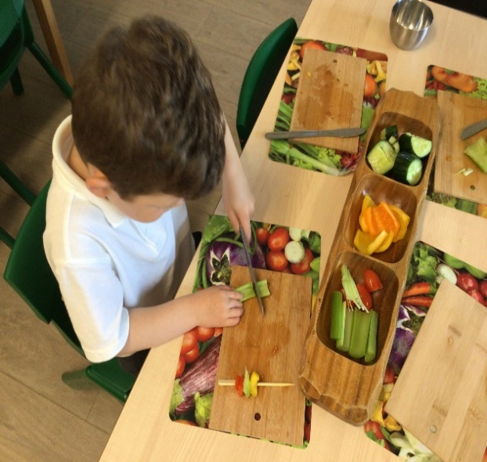

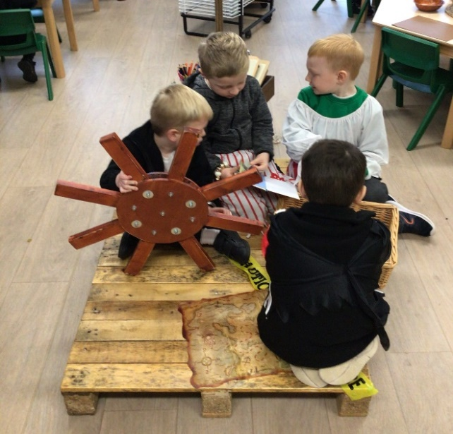
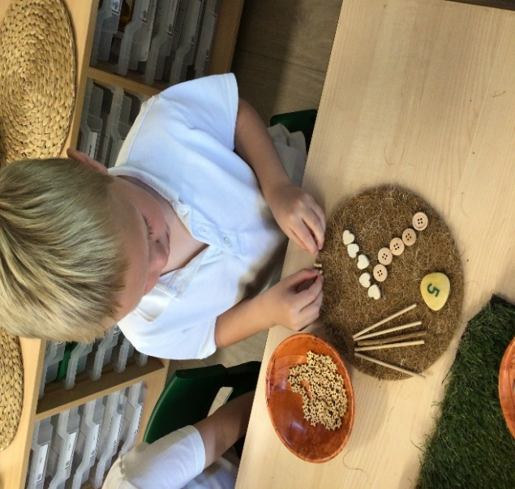
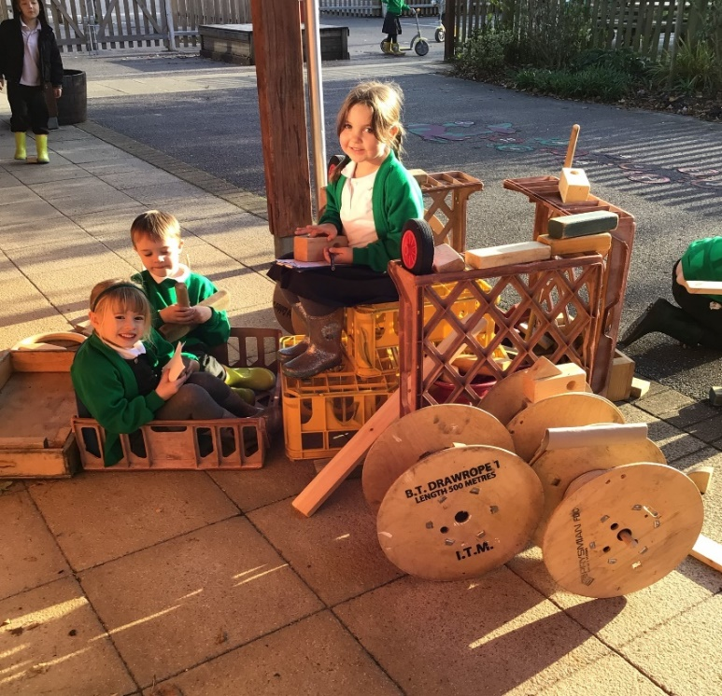
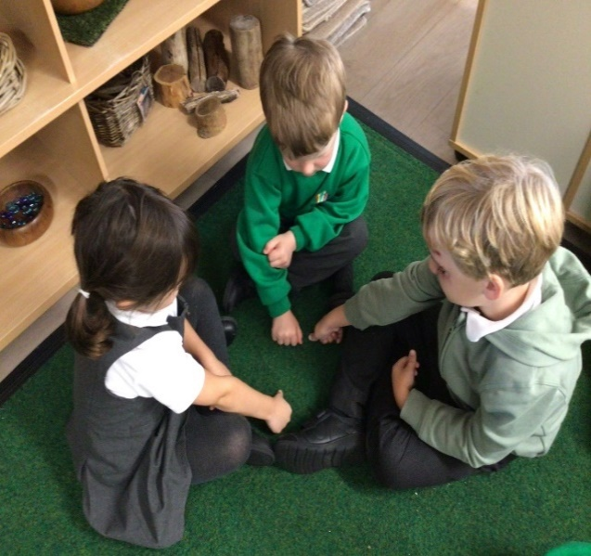
….
‘The wider the range of possibilities we offer children the more intense will be their motivations and the richer their experiences.’
Louis Malaguzzi
In reception at Abbots Green the curriculum and care given supports the whole child, recognising their characteristics of learning alongside their emotional well-being.
It is our aim that children will leave the EYFS as confident, independent and reflective learners.
‘Every day we come together to grow as individuals. We challenge ourselves and celebrate successes as we create our pathway for the future.’

