Slide 1


RSE at
Abbots Green
RSE

Slide 2
What is RSE?
Relationship, Sex Education
‘The aim of RSE is to give young people the information they need to help them develop healthy, nurturing relationships of all kinds, not just intimate relationships. It should enable them to know what a healthy relationship looks like and what makes a good friend, a good colleague and a successful marriage or other type of committed relationship. It should also cover contraception, developing intimate relationships and resisting pressure to have sex (and not applying pressure). It should teach what is acceptable and unacceptable behaviour in relationships’ DfE 2021
RSE

Slide 3
When is RSE taught?
At Abbots Green RSE is taught during summer term 2 using the Jigsaw scheme of work to outline what is covered.
RSE

Slide 4
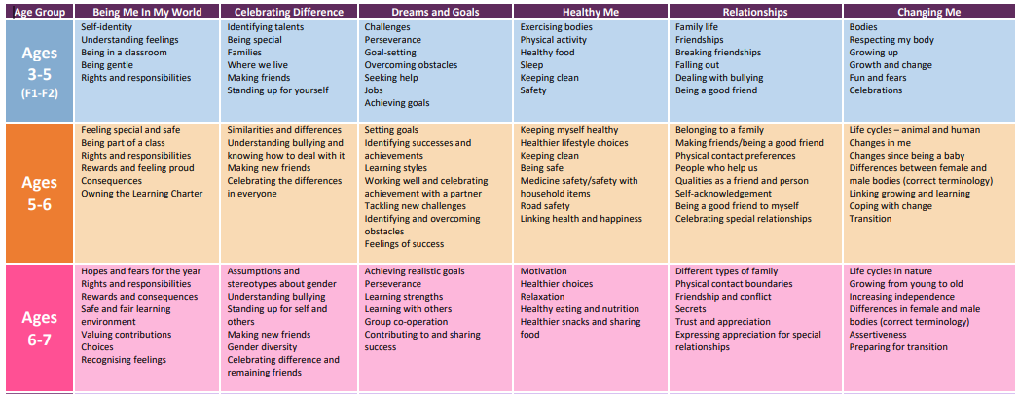
What is taught?
RSE

Slide 5
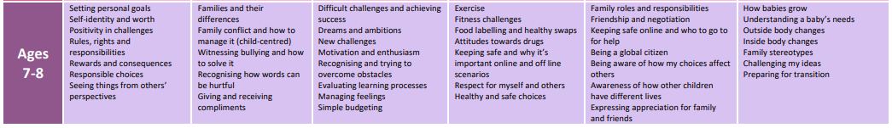
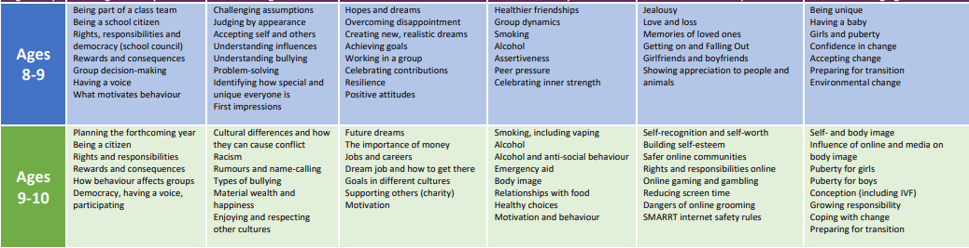
What is taught?
RSE

Slide 6
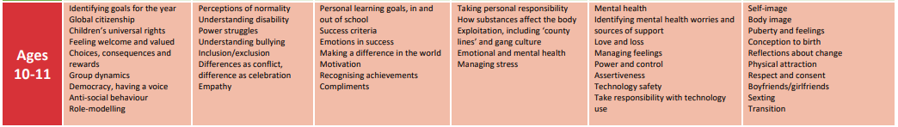
What is taught?
RSE

Slide 7
What is taught?
Vocabulary-
Scientific terminology will be used during RSE lessons. Here is a list of some of the vocabulary used in year groups.
Year 5:
Puberty
Periods
Sanitary towels
Tampons
Ovary/ Ovaries
Vagina
Vulva
Sperm
Testicles/Testes
Facial hair
Growth spurt
Hormones
Year 2:
Male
Female
Vagina
Penis
Testicles
Vulva
Anus
Public
Private
Year 3:
Puberty
Testicles
Sperm
Penis
Ovaries
Egg
Ovum/ Ova
Womb/ Uterus
Vagina
Year 4: Sperm
Egg/ Ovum
Penis
Testicles
Vagina/ Vulva
Womb/ Uterus
Ovaries
Fertilise
Conception
Year 6:
Pregnancy
Embryo
Foetus
Placenta
Umbilical cord
Labour
Contractions
Cervix
Midwife
Year 1:
Male
Female
Vagina
Penis
Testicles
Vulva
Anus
RSE

Slide 8
School and Home Working Together
“The role of parents in the development of their children’s understanding about relationships is vital. Parents are the first teachers of their children. They have the most significant influence in enabling their children to grow and mature and to form healthy relationships.”
Relationships Education, Relationships and Sex Education (RSE) and Health Education Draft statutory guidance for governing bodies, proprietors, head teachers, principals, senior leadership teams, teachers - DfE, June 2019
RSE

Slide 9

Growing up in 21st Century Britain
PSHE lessons in schools including lessons that focus on relationships and sex education are taught very differently to the lessons you may have had (or not had) in school. We are also living in a different society and preparing children to be active citizens in a very different world.
RSE

Slide 10
Current RSE Legislation and Guidance
All schools must provide a curriculum which ‘promotes the spiritual, moral, cultural, mental and physical development of pupils at the school and of society, and prepares pupils at the school for the opportunities, responsibilities and experiences of later life.’ (Education Act 2002 and Academies Act 2010)
Under the Children Act 2004 maintained schools also have a statutory duty to promote children and young people’s well-being - RSE can contribute to this duty
Under the Equality Act 2010 schools are expected to ensure that those with protected characteristics are not discriminated against and are given equality of opportunity.
‘Working together to safeguard children’ 2018 and ‘Keeping children safe in education’ 2019 – RSE contributes to safeguarding through the curriculum
RSE

Slide 11
Current RSE Legislation and Guidance
The DfE introduced statutory guidance on Relationships and Sex Education, Relationships Education and Health Education. This new guidance replaces the DfE Sex and Relationships Education Guidance from 2000. The guidance became mandatory in September 2020 - The expectations on schools are as follows:
• Relationships Education will be compulsory in all Primary Schools (or those pupils receiving Primary Education
• Relationships and Sex Education will be compulsory in all Secondary Schools (or those pupils receiving Secondary Education)
• Health Education will be compulsory in all Primary and Secondary Schools (or those pupils receiving Primary or Secondary Education)
RSE

Slide 12
Statutory Curriculum
Can I withdraw my child from the RSE curriculum based on religious beliefs?
No. Parents can not withdraw children from statutory curriculum.
Parents have the right to withdraw their children from the non-statutory components of sex education within RSE. If a parent wishes their child to be withdrawn from this part of the programme, they should discuss this with the Headteacher, and make it clear which aspects they do not wish their child to participate in. The school always complies with the wishes of parents in this regard. Parents are required to confirm this in writing.
Lessons children can be withdrawn from:
Year 4, Lesson 2 (Having a baby)
Year 5, Lesson 4 (Conception)
Year 6, Lesson 3 (Conception, birth)
RSE

Slide 13
Importance of all children receiving these lessons
• creates a supportive atmosphere and a shared understanding of these topics.
• helps to encourage empathy and an understanding of the wider school community which supports our anti-bullying policy.
• Creates a safe space to learn with ground rules as well as the usual class rules.
• Lesson led by the class teacher who knows the children and understands their needs in terms of learning styles, additional support needed and finding out what their current understanding of a topic is.
• The class teacher has been trained to delivered the lessons.
• Children are naturally curious and we feel that it is better to know they are getting accurate, up to date, age appropriate information rather than finding the answer to their questions by searching online, for example.
RSE

