Slide 1
Find out who we are and what we do…
Month by month…

Slide 2
Mrs Uttley and Mrs Morrison completed the Safety Survey with all the children of Abbots Green – they were so impressed with the children’s responses and suggestions, that they decided to create roles for the children to help them ‘Keep Children Safe in Education’.

Slide 3
The following roles were advertised:
Join the Abbots Green SAFETY SQUAD
We need 1 child from each year group to help us all keep safer in school.
We will try to make it safer for us outside of school – e.g the park.
We will think of ways to help people stay safe online
We will work with people in our community e.g. the police; local shops
We will meet every week – sometimes this will be at lunchtimes.
Do you have the rainbow values that we need?

Slide 4
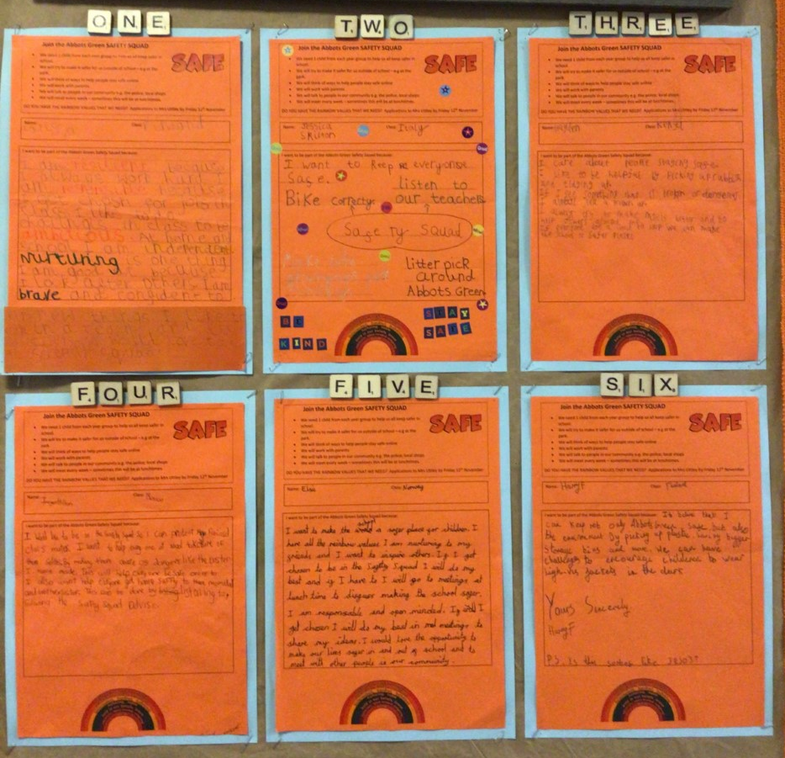
We had over 100 applicants!
These were the successful applications.

Slide 5
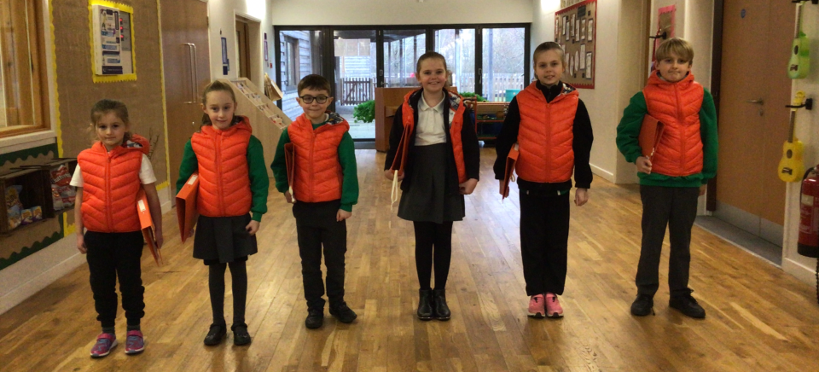
Larissa Jessica Hayden Imogen Elsie Harry
Year 1 Year 2 Year 3 Year 4 Year 5 Year 6

Slide 6
We have been getting know to each other
Our orange gilets arrived!
We have clip boards; a folder; a notice board; tablets to take photographs; and even an orange peg!
We found out about the Keeping Children Safe in Education document
We know about the school’s security cameras

Slide 7
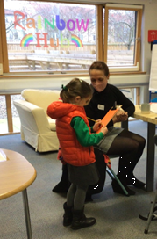
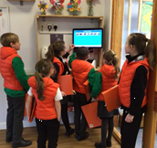
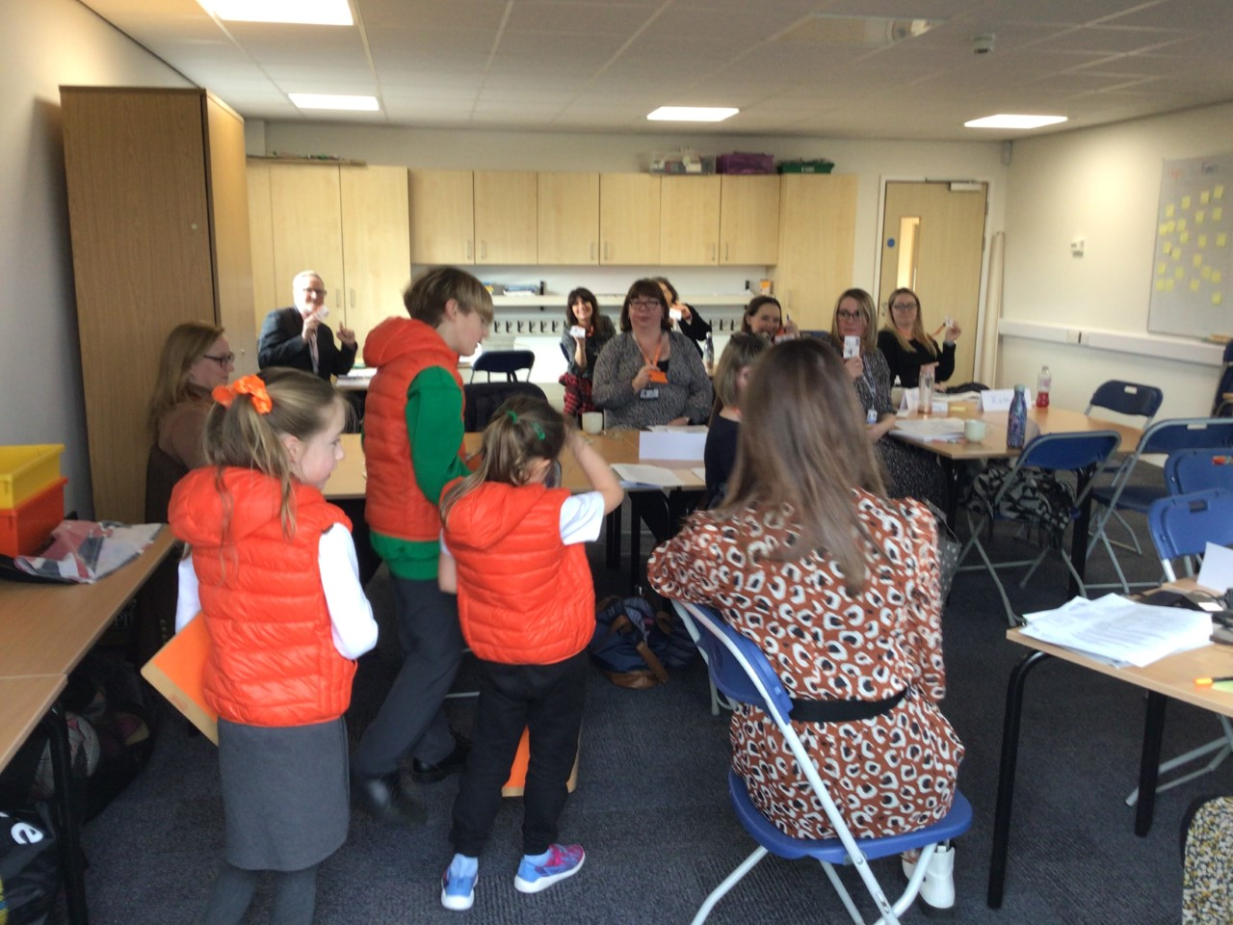
We check visitors to make sure they have signed in and that they are wearing a lanyard.

Slide 8
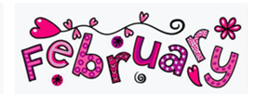
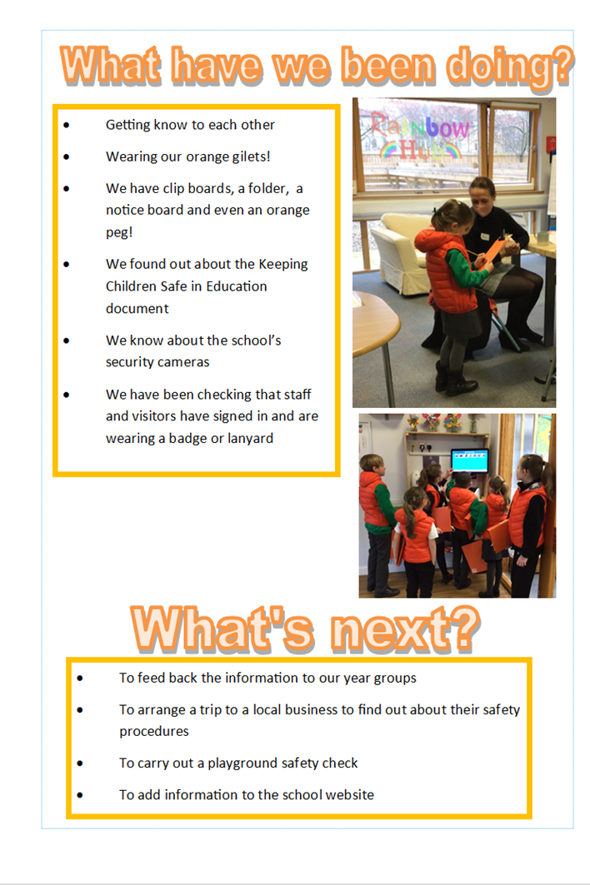
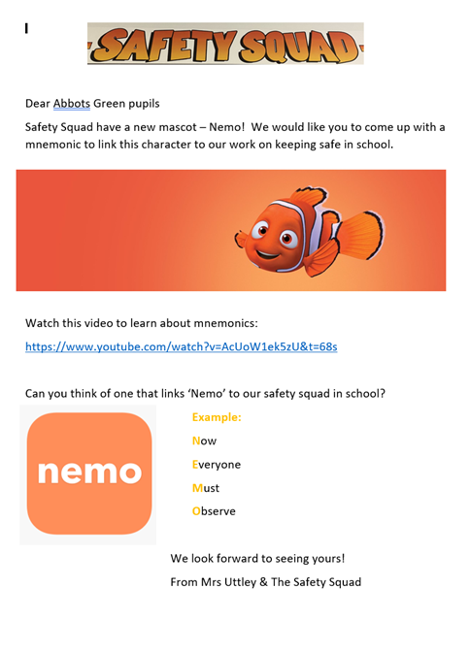
Our first appearance in the Jolly News; we will have a double page spread in each edition.
Whole school competition launched to find a mnemonic for our new Safety Squad mascot – Nemo.

Slide 9
March 2022
We had our first Safety Squad meeting after school
We wrote to a local company to ask if we could visit them to look at what they do to keep their staff safe.
We decided on the winner of the NEMO competition and announced it in assembly.
Now
Everyone
Makes
Our school safe

